Slide 1
Topic: Agile model overview
By
Akash A

Slide 2
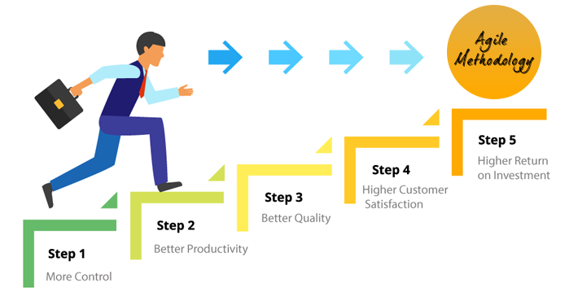
Agile model overview
In earlier days Iterative Waterfall model was very popular to complete a project. But nowadays developers face various problems while using it to develop software. The main difficulties included handling change requests from customers during project development and the high cost and time required to incorporate these changes.
To overcome these drawbacks of Waterfall model, the Agile Software Development model was proposed.
The Agile model was primarily designed to help a project to adapt to change requests quickly. So, the main aim of the Agile model is to facilitate quick project completion. To accomplish this task agility is required.
Agility is achieved by fitting the process to the project, removing activities that may not be essential for a specific project. Also, anything that is wastage of time and effort is avoided.
Actually Agile model refers to a group of development processes. These processes share some basic characteristics but do have certain subtle differences among themselves. A few Agile SDLC models are given below:
Crystal
Feature-driven development
Scrum
Extreme programming (XP)
Unified process

Slide 3
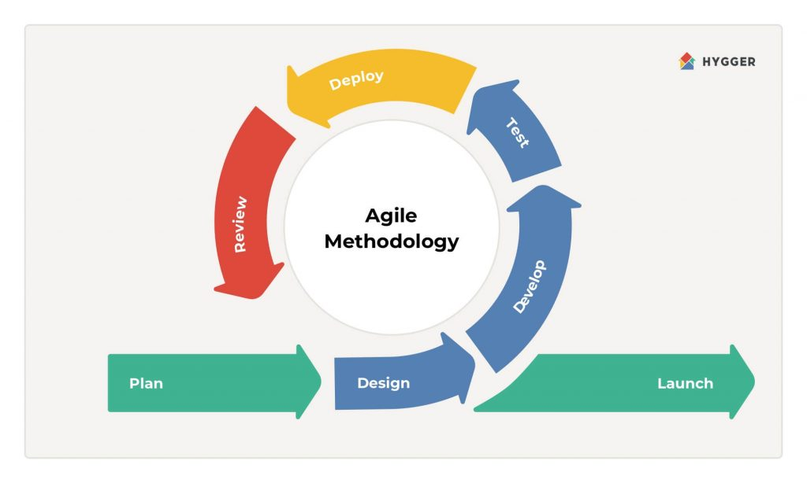
Agile process:
In the Agile model, the requirements are decomposed into many small parts that can be incrementally developed.
The Agile model adopts Iterative development.
Each incremental part is developed over an iteration.
Each iteration is intended to be small and easily manageable and that can be completed within a couple of weeks only.
At a time one iteration is planned, developed and deployed to the customers. Long-term plans are not made.
Agile model is the combination of iterative and incremental process models. Steps involve in agile SDLC models are
Requirement gathering
Requirement Analysis
Design
Coding
Unit testing
Acceptance testing

Slide 4

Principles of Agile model:
To establish close contact with the customer during development and to gain a clear understanding of various
requirements Agile model relies on working software deployment rather than comprehensive documentation.
Frequent delivery of incremental versions of the software to the customer representative in intervals of few weeks.
Requirement change requests from the customer are encouraged and efficiently incorporated.
Working software is the primary measure of focus.
Sponsors, developers and users should be able to maintain a constant pace.
It emphasizes on having efficient team members and enhancing communications among them is given more importance.

Slide 5

It is recommended that the development team size should be kept small (5 to 9 people) to help the team members meaningfully engage in face-to-face communication and have collaborative work environment.
Agile development process usually deploy Pair Programming. In Pair programming, two programmers work together at one work-station. One does coding while the other reviews the code as it is typed in. The two programmers switch their roles every hour or so.
Contineous attention to technical excellence and good design enhances agility.
The best architecture, requirement and designs emerge from self organizing team.

Slide 6

Advantages of Agile:
Working through Pair programming produce well written compact programs which has fewer errors as
compared to programmers working alone.
It reduces total development time of the whole project.
Customer representatives get the idea of updated software products after each iteration.
So, it is easy for him to change any requirement if needed
Disadvantages of Agile:
Due to lack of formal documents, it creates confusion and important decisions taken during
different phases can be misinterpreted at any time by different team members.
Due to the absence of proper documentation, when the project completes and the developers
are assigned to another project, maintenance of the developed project can become a problem.

Slide 7
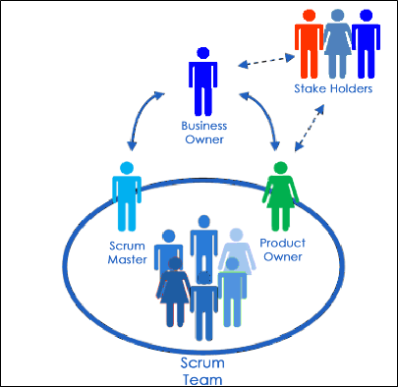
Scrum:
Scrum is an agile development methodology used in the development of Software based on an iterative and incremental
processes.
Scrum is adaptable, fast, flexible and effective agile framework that is designed to deliver value to the customer throughout the
development of the project.
Events in Scrum:
Sprint
Sprint planning
Daily Scrum
Sprint review
Sprint retrospective
The Scrum Team
The fundamental unit of Scrum is a small team of people, a Scrum Team. The Scrum Team consists of one Scrum Master,
one Product Owner, and Developers. Within a Scrum Team, there are no sub-teams or hierarchies. It is a cohesive unit of
professionals focused on one objective at a time, the Product Goal.

Slide 8
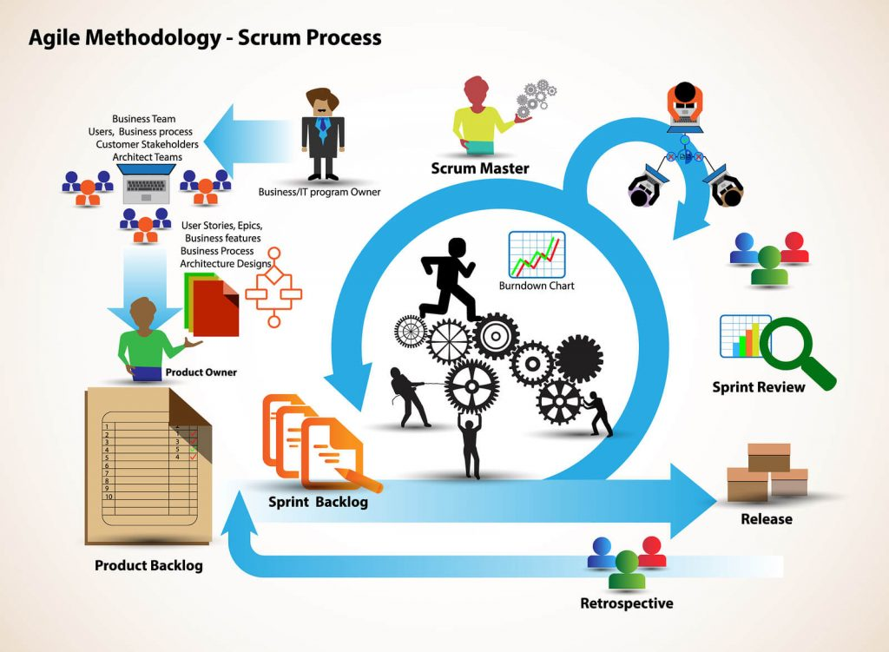

Slide 9
Thank you

